Slide 1
Artist Profiles
I have included Walter Bailey, Rick Kirby and David Begbie in this section because I particularly liked their work when I saw it at the Hannah Peschar Sculpture Garden. All images in this section were taken there unless specified otherwise. I have included Peter Callesen because I enjoy searching for new artists and his work interested me.
Walter Bailey
Rick Kirby
David Begbie
Peter Callesen

Slide 2
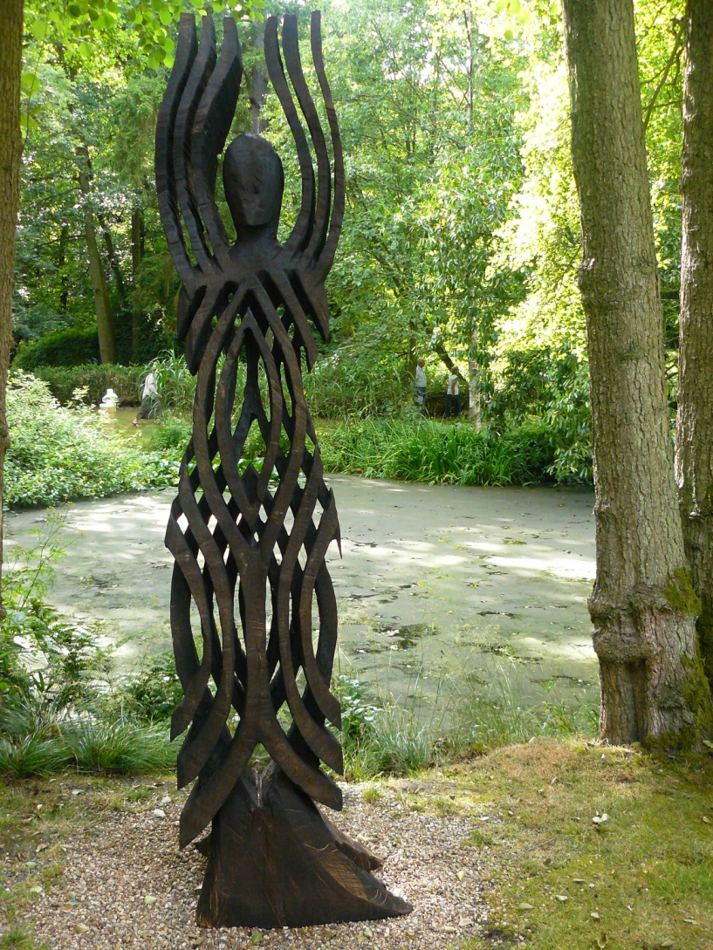
Walter Bailey
Sophia
Scorched English oak 260cm x 67cm x 50cm
‘Responding to the limitations and possibilities inherent in a fallen tree creates a dynamic dialogue with the material. Carving directly with a chainsaw is a fast and intuitive method, allowing for a focused realisation of imagined form. My work in landscape and for interiors seeks to create surprise, mystery, I am at heart a celebrant.’

Slide 3
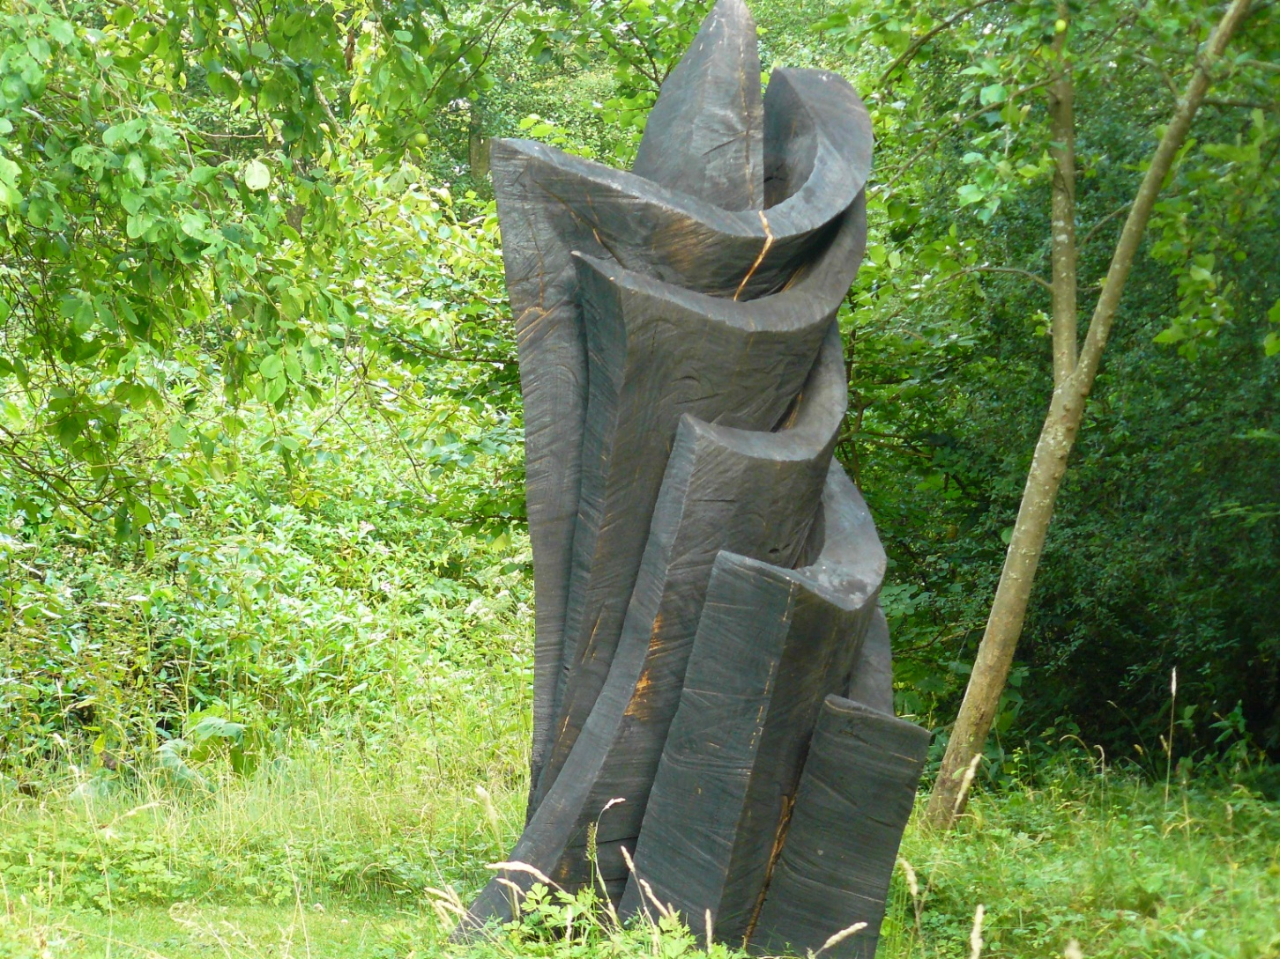
Walter Bailey Unfurling charred oak 235cm x 150cm

Slide 4
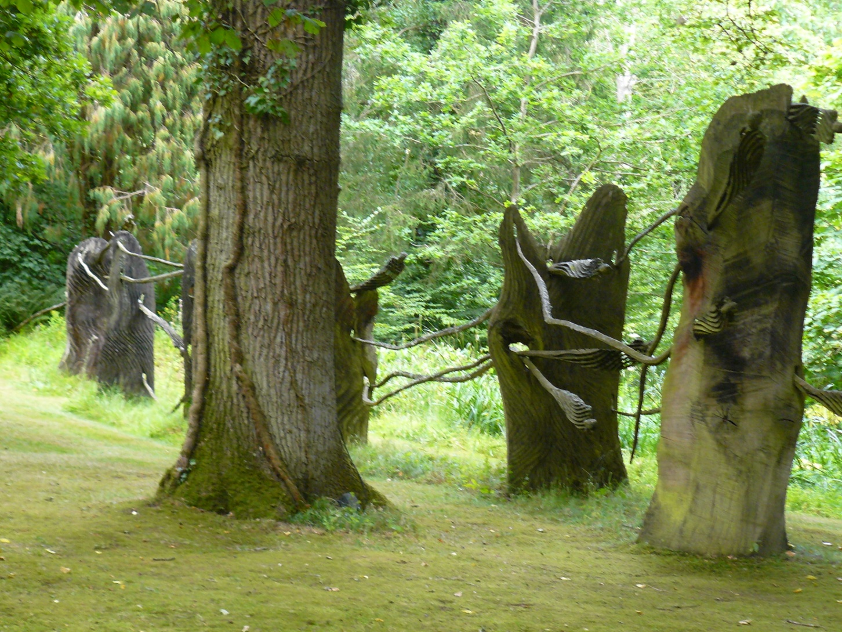
Walter Bailey Journey Work Scorched and untreated oak approx. 1980cm x 270cm x 180cm

Slide 5
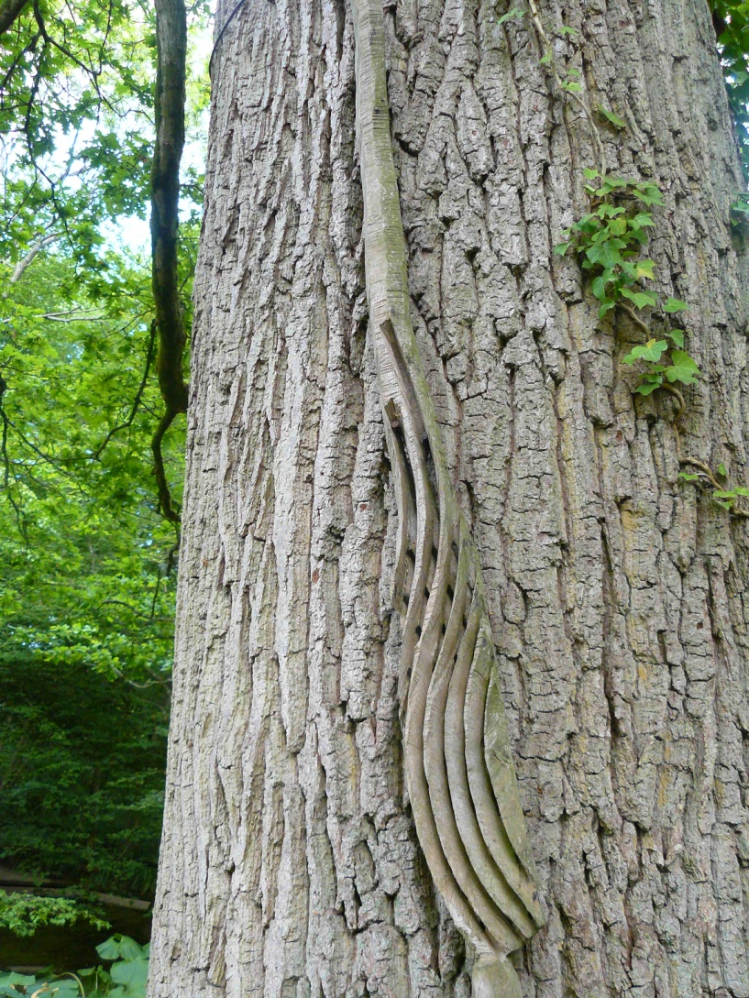
Walter bailey On Stream III oak 110cm x 340cm x 36cm

Slide 6
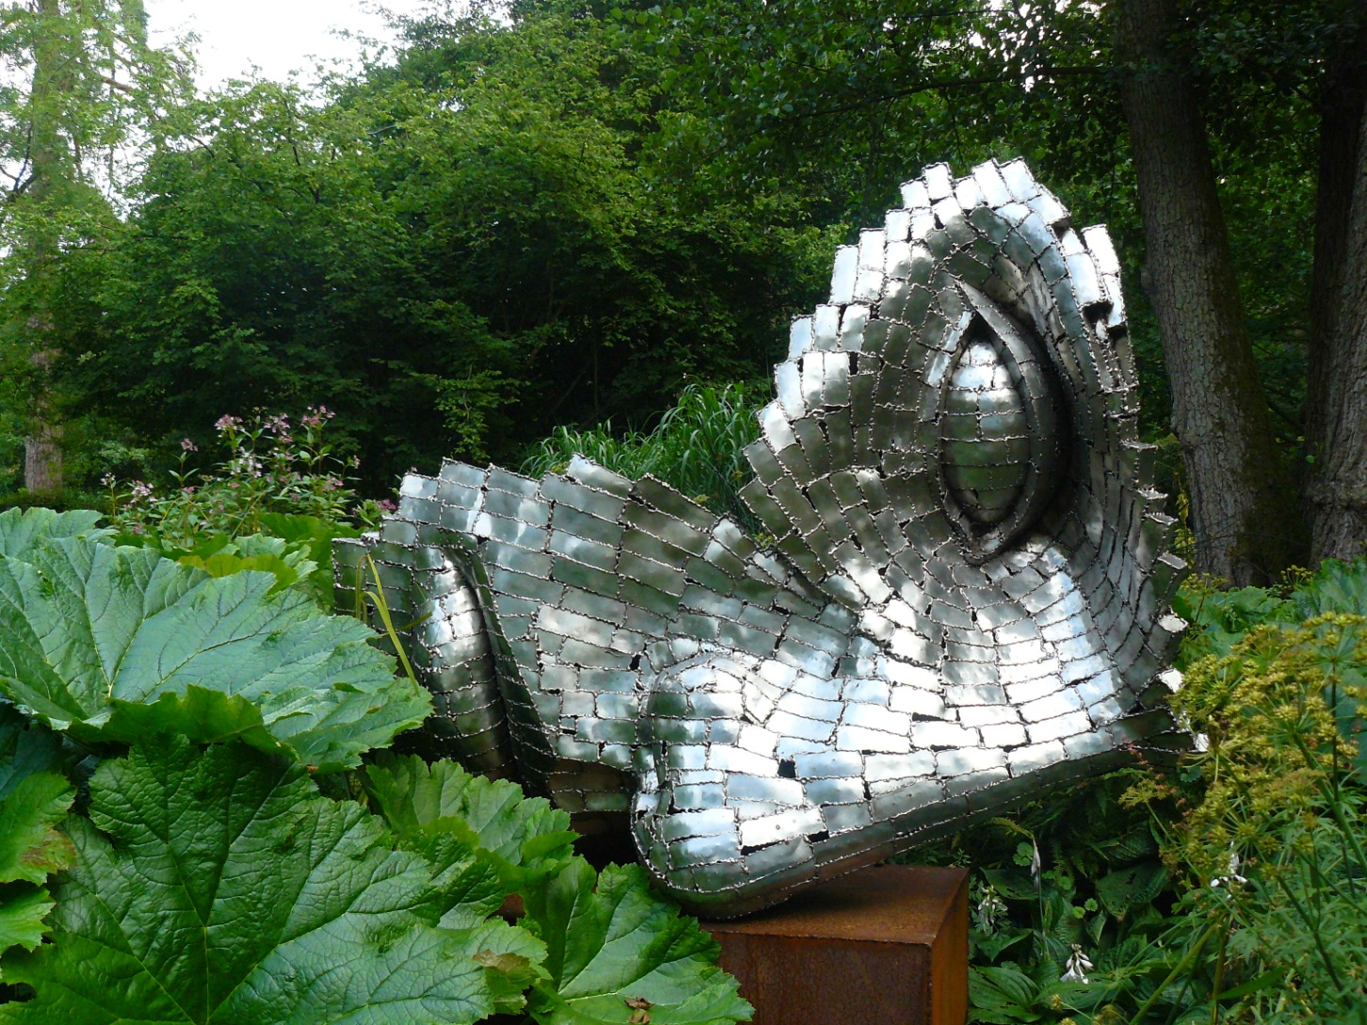
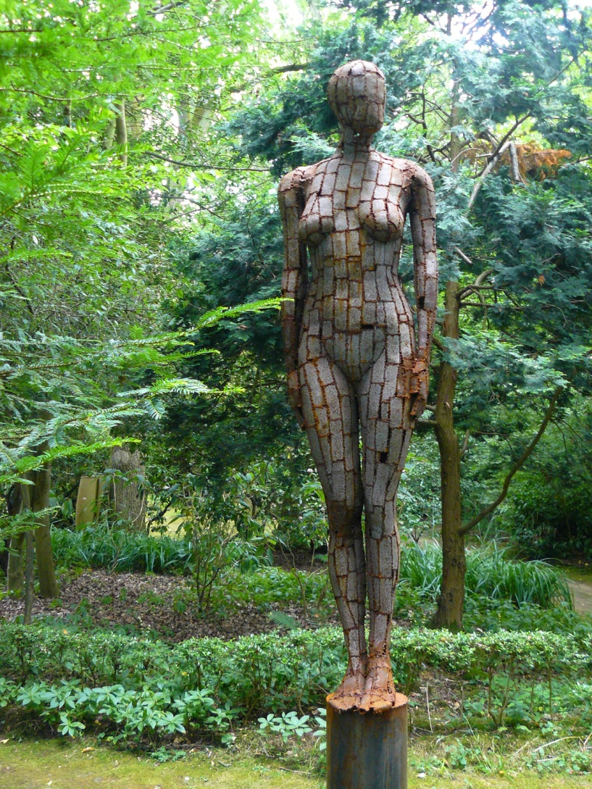
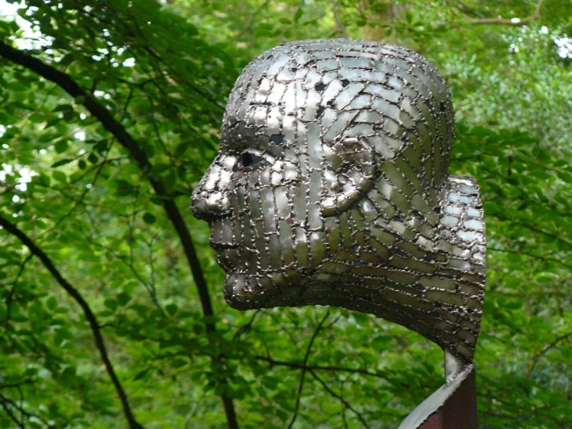
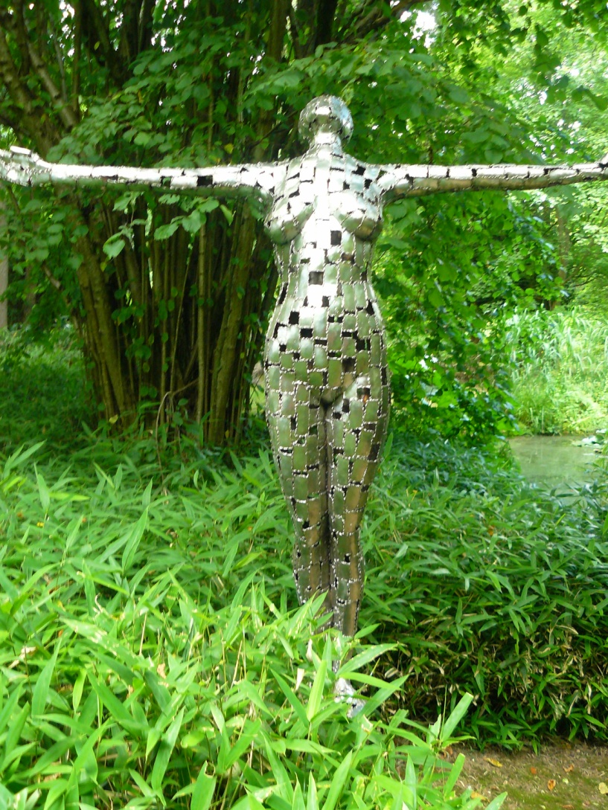
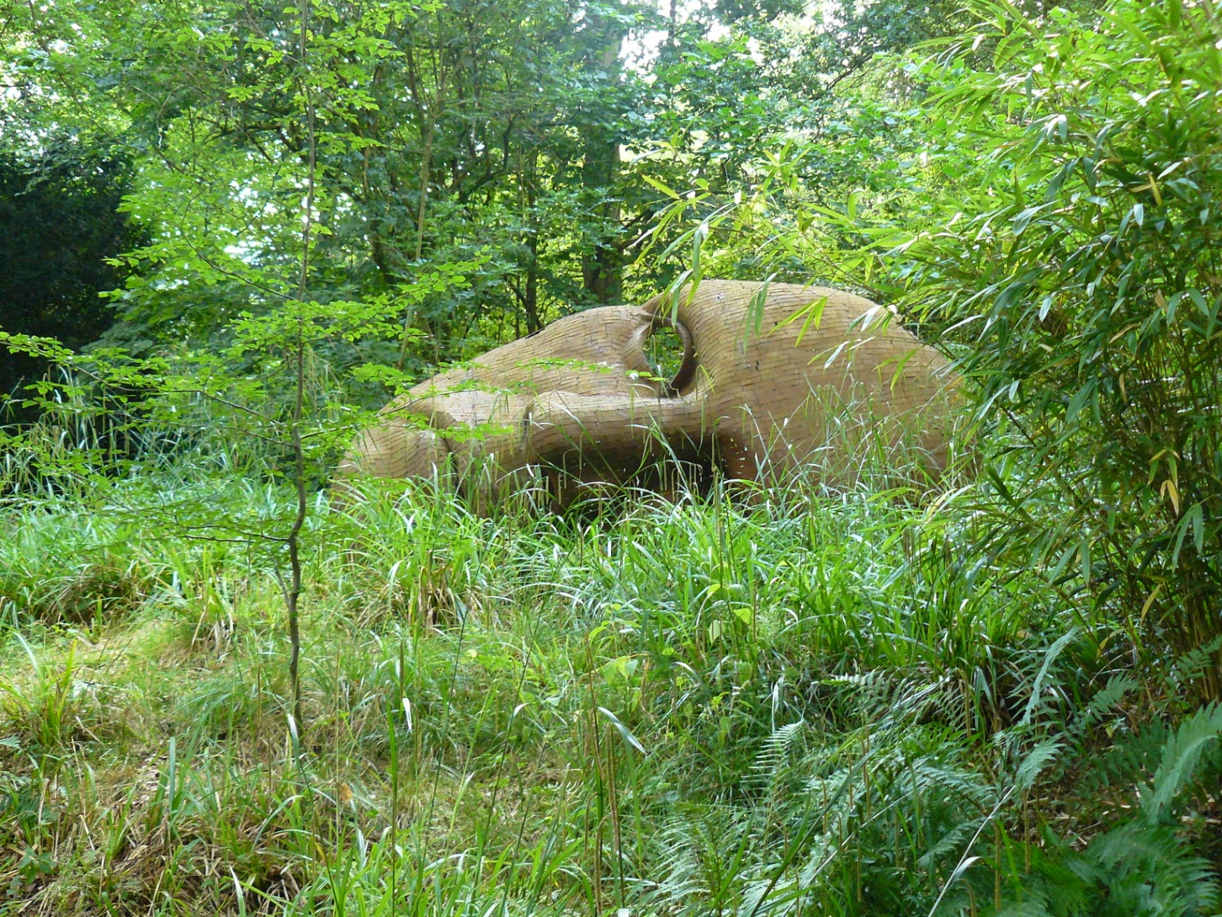
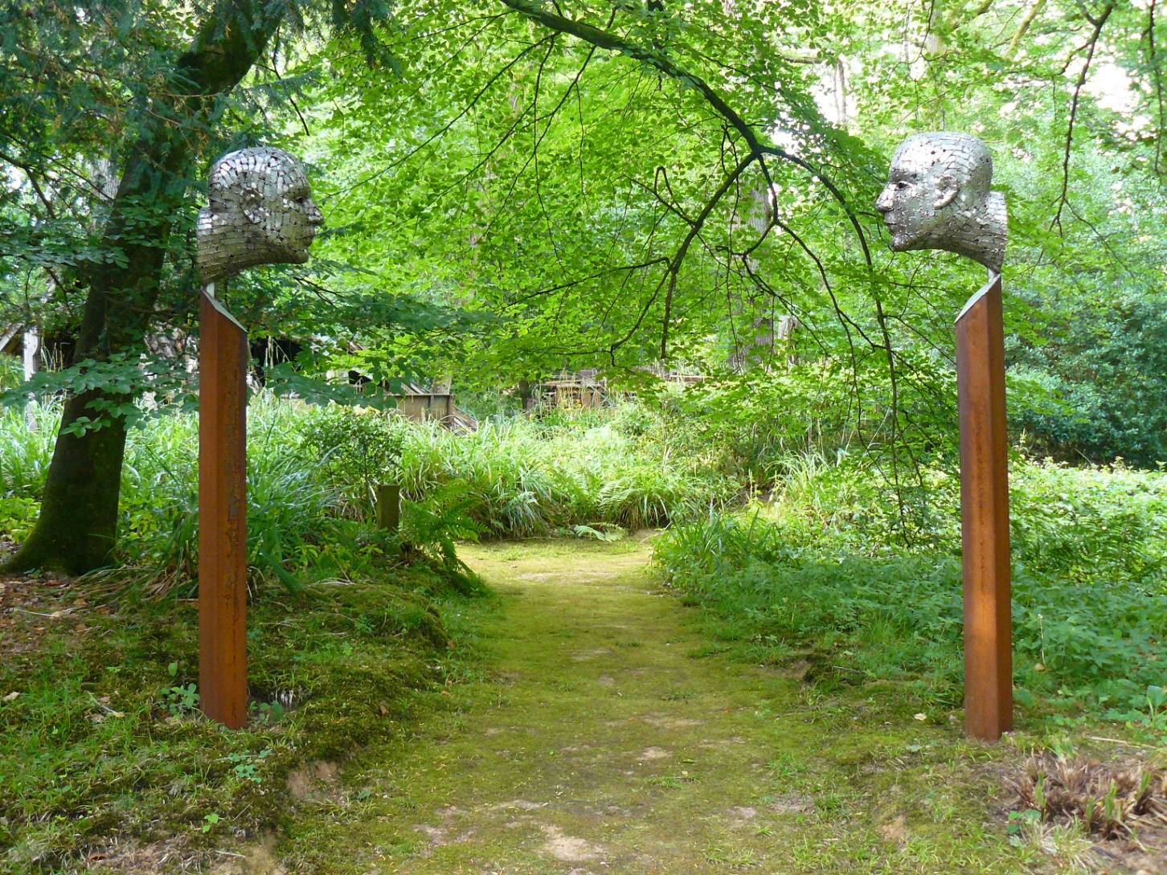
Rick Kirby

Slide 7
Rick Kirby uses welded steel to create sculptures of the human
form.
Contrast forms the basis of his work; the cold, hard, industrial
steel is shaped to mimic the gentle curves of the human form.
Kirby’s sculptures challenge our perception of steel as a material.
His ‘patchwork’ style of sculpting imbues the steel with more human
qualities: the way that the steel catches the light, the way in which the
mild steel oxidises with age, rusting at the edges, turning shades of
bronze and developing imperfections. These imperfections highlight
the uniqueness of each sculpture rather in the way human
imperfections do.
Thus Kirby breathes life into a material which is cold and lifeless in its original state.
The environment shapes the appearance of the mild steel sculptures. The rust on ‘Witness’ gives it a warmer
colour and gives it permanence because it suggests that the sculpture has been standing for years. The fact that
Kirby’s sculptures do not look out of place in the Hannah Peschar Sculpture Garden in rural Surrey is a testament
not only to his skill in ‘humanising’ the steel but his trust in the elements to age the sculptures in the desired way.
Kirby’s experiences have shaped how he sculpts:
‘Industrial influences loom large in his life. The giant heads he creates are reminiscent of the old ships he had seen when his family lived in Portsmouth. [...] It left a profound impression. What he was witnessing then was Britain’s great shipping industry in its dying throes. The ribs of the ships he had seen as a child are echoed in the structure of his sculptures, in particular in the make-up of the huge heads lying on their sides.’
Neeta Borah, interview with Rick Kirby, January 2008 http://www.rickkirby.com/interview.htm
Detail from Zen Face to Face

Slide 8
Zen Face to Face stainless steel and mild steel base 250 x 41 x 17 each

Slide 9
Witness mild steel 264 x 40 x 40

Slide 10
Fallen Angel stainless steel and mild steel 196cm x 155cm x 57cm

Slide 11
Open Cry stainless steel 201cm high

Slide 12
Broadside mild steel 459cm x 200cm x 120cm

Slide 13
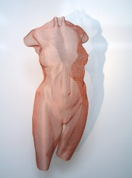
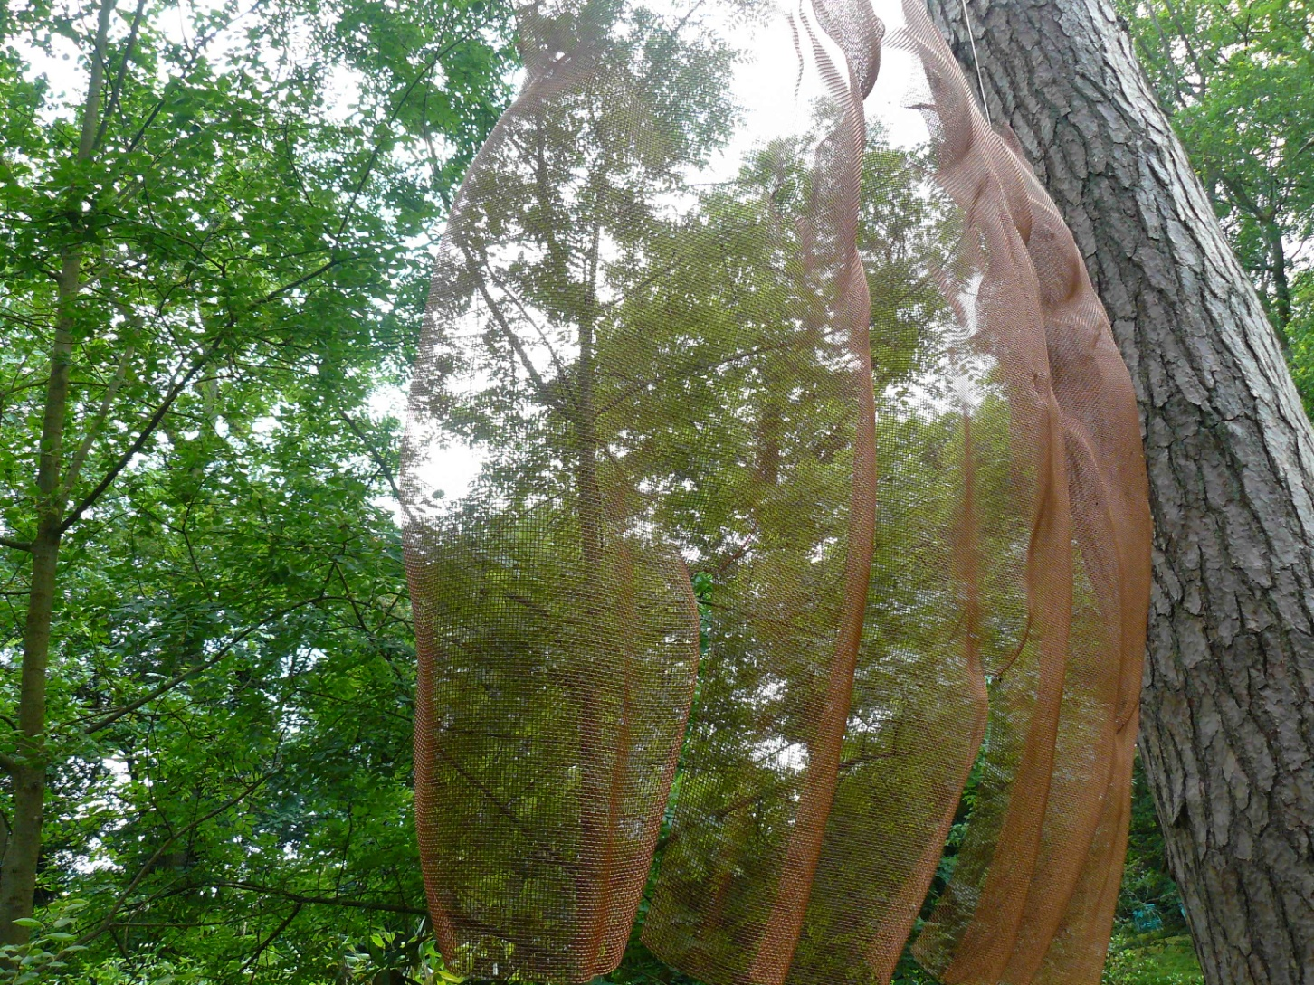
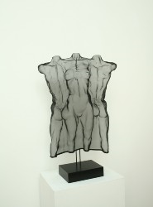
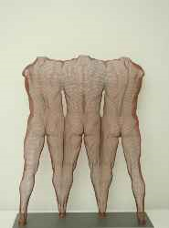
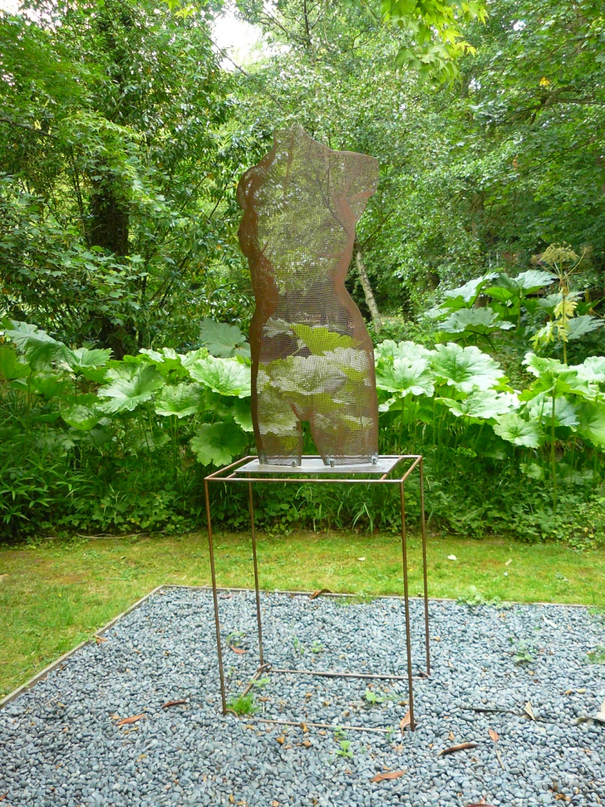
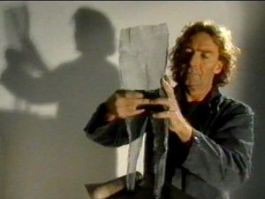
David Begbie
‘Anude’ 2009
‘manwoman’ 1995
‘Tritus’ 2010
Images which are not my own are from http://www.davidbegbie.com/index.cfm/main.view/gallerydifferent

Slide 14
David Begbie’s sculptures are made by hand.
‘Begbie takes a flat sheet of steelmesh, which,
when it has no structure, is quite malleable. He cuts out
the basic shape of his idea then he works the mesh with his hands,
much as another sculptor would work with clay. The only technical
intervention is when the sculpture has to be welded onto its base.
The shadows created by lighting the sculpture are an integral part
of the whole and something which David is conscious of when
working in his studio. He is aware at every stage of the
multi-dimensional effect of each artistic decision he
makes.’
Begbie’s skill lies in his ability to craft the mesh to mimic the
curves of the human body so that his sculptures look very solid and real. Due to the translucency of the mesh they also take on an ethereality and a softness which complements his representation of the human form.
He says of his sculpture ‘each work is an entity which has a far greater physical presence than any solid object could possibly have because it has the power to suggest that it doesn’t exist.’
“One of the reasons for steelmesh in art schools is because it is a traditional material for armature [...] I thought these unsophisticated armatures were completely unappreciated as a potential art form and decided to reinterpret the guts of the sculpture, as I saw it - a strong and important statement in it’s own right.”
I like that Begbie creates sculptures of the human form using what would traditionally have been the ‘skeleton’ of a plaster sculpture, reinterpreting the discipline of sculpture and displaying the true beauty of bronzemesh in its own right. This, coupled with his method of working the mesh with his hands, gives Begbie’s creative process a humanity which holds a particular symmetry with his subject matter.
I was impressed by how the sculptures’ dynamism and suggestiveness contrast with their understated subtlety.
Begbie working
http://www.davidbegbie.com/index.cfm/main.view/productionofthework

Slide 15
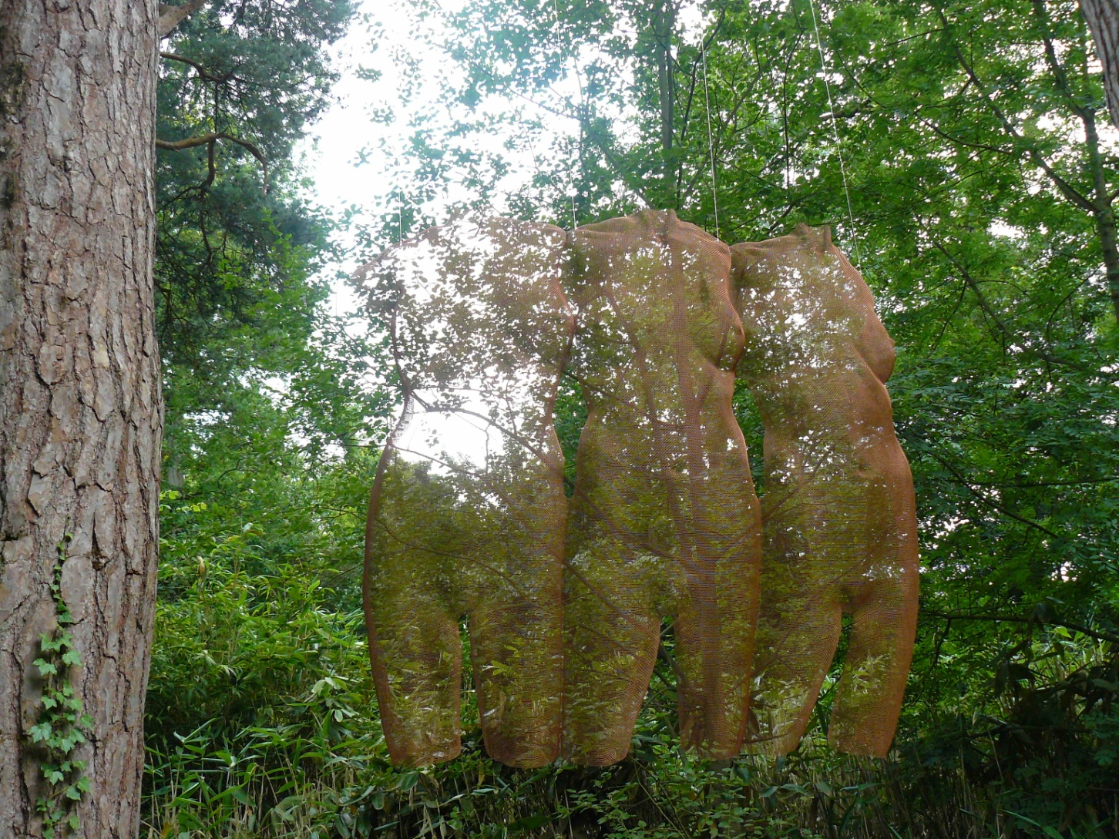
Threetruncs (no date given) Bronzemesh 149cm x 37cm x 30cm

Slide 16
Threetruncs in profile

Slide 17
Venus 2009 Phosphor Bronze 120cm x 62cm x 15cm

Slide 18
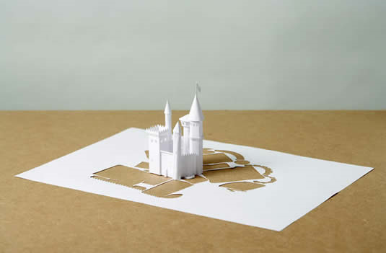
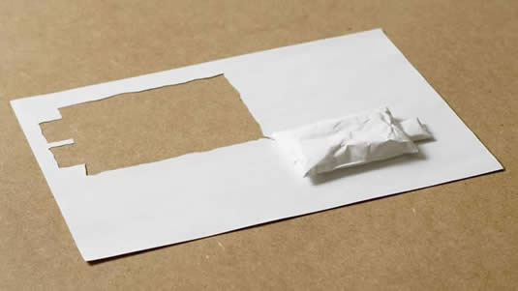
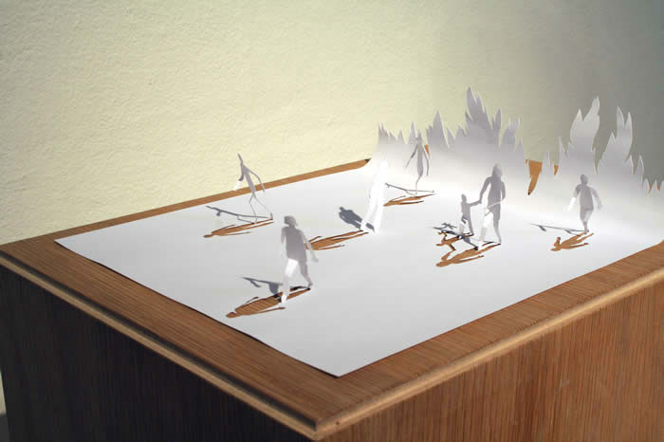
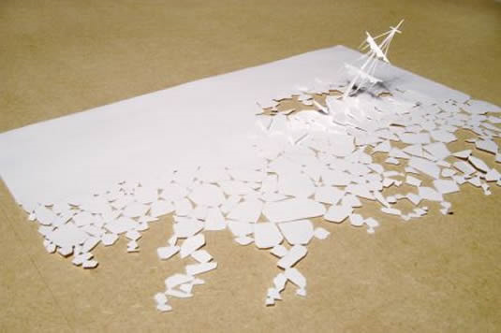
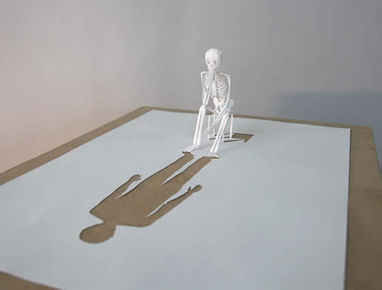
Peter Callesen
All images are from
http://www.petercallesen.com/

Slide 19
‘Lately I have worked almost exclusively with white paper [...] A large part of my work is made from A4 sheets of paper. It is probably the most common and consumed media used for carrying information today. This is why we rarely notice the actual materiality of the A4 paper.’
The above quotation emphasises what I like about Callesen’s artwork: his use of such an ordinary everyday expendable material to create intricate clever works of art.
Through his papercutting work Callesen changes the nature of the medium: white paper is no longer clinical, dull, two-dimensional; it becomes alive, something of beauty and romance.
Callesen’s subject matter highlights the original dullness of the paper. Underpinned by a romantic theme, his work includes majestic pagodas (The Short Distance Between Time and Shadow) and castles (Impenetrable Castle). These intricate designs show Callesen’s talents as a designer and as a creator.
The theme of mortality features heavily. Running Fire II, Walking Snail, Eismeer, and Looking Back contemplate the passage from life to death. These pieces have a tension within them, a feeling that something is happening which gives a sense of the passage of time.
The fragility and disposability of the paper reflects the theme of mortality.
Callesen uses negative space to great success, bringing subjects to life by giving them shadows and furthering their three-dimensionality. This emphasises the transformation from two dimensional to three dimensional and adds another aspect to the narrative of a piece. Ultimately Callesen’s use of negative space makes his work more relatable through increasing the realism of his work.

Slide 20
Single Double Bed Acid-free A4 80gsm paper and glue 2005

Slide 21
Running Fire II Acid free A4 115gsm paper and glue 2010

Slide 22
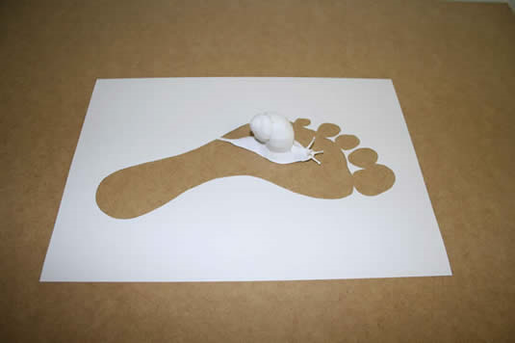
Walking Snail Acid free A4 115gsm paper and glue 2006

Slide 23
Eismeer Acid free A4 80gsm paper and glue 2006

Slide 24
Looking Back Acid free A4 115gsm paper and glue 2006

Slide 25
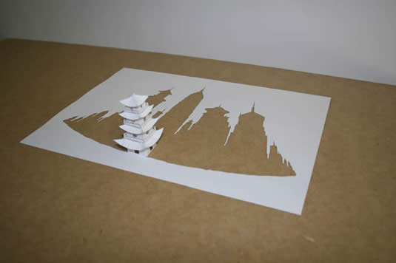
The Short Distance Between Time and Shadow Acid free A4 115gsm paper and glue 2006

Slide 26
Impenetrable Castle Acid free A4 115gsm paper and glue 2005

Slide 27
Future
Below I list what I am particularly interested in studying on the Foundation
course:
Screen printing
Textiles
Film photography
Fashion Design
Large scale pieces
Sculpture

